Slide 1
Nichole
18+ Transition Plan
Thursday April 19, 2018

Slide 2

Interests
Drinking starbucks
Shopping at the mall
Cooking with my family
Walking my dogs with my brother
Playing volleyball with my friends

Slide 3

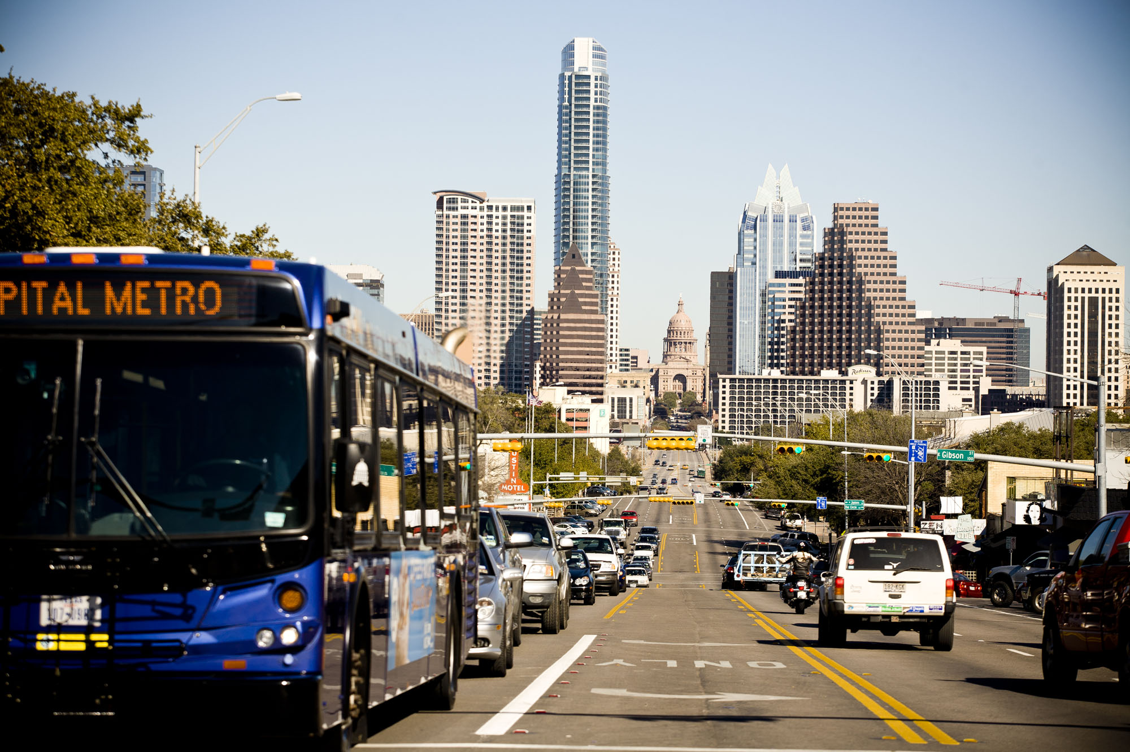
Post-Secondary-ACC STEPS
In Fall of 2018 I will start classes at ACC Highland Business Center.
The classes I want to take are: Professionalism in the Workplace and Academic Skills.
I will get to ACC using the city bus.

Slide 4

18+ at KAC
Speech with Ms.Garcia
Job Exploration and Volunteer Opportunities
In-Home Training:
Cooking
Daily Chores
Making a Grocery List and Meal Planning
Pet Care

Slide 5

Needs
Using time to plan my day
Open a bank account
Balance my account
Applying and interviewing for a paid job

